Slide 1

Ranting vs Venting
Subreddits classification
Ilya Kvyatkovskiy for GA
Project 3, October 2019

Slide 2
Project Scope and workflow
Statement:
Pick two subreddits from www.reddit.com, and identify the best classification model
Project stages:
Data collection and evaluation
Data preparation
Modeling
Models evaluation
Conclusions and recommendations

Slide 3

RANTING And VENTING - Initial subreddits choice
AskMen
vs.
AskWomen

Slide 4
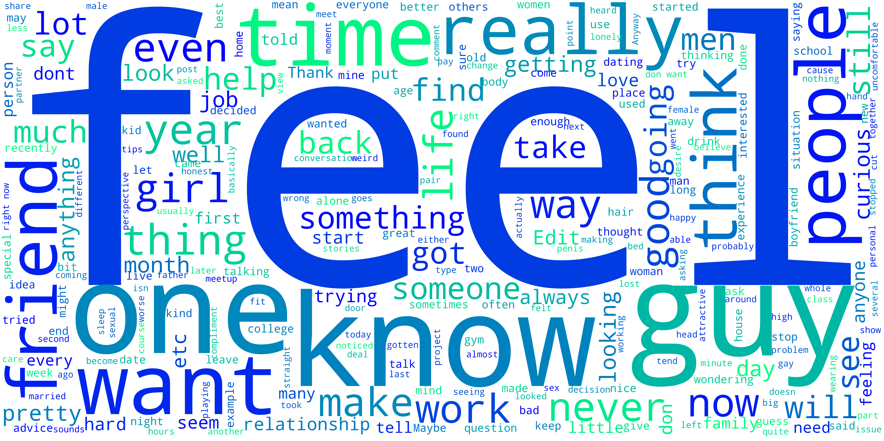

BASELINE MODEL
272 Posts
404 Posts
132 Posts
Baseline model accuracy = 272 / 404 = 0.6733

Slide 5
LOGISTIC REGRESSION & NAIVE BAYES MODELS
 | Count Vectorizer |  | TF-IDF Vectorizer
 | Training Set | Testing Set | Training Set | Testing Set
Logistic Regression | 0.9967 | 0.7492 | 0.8581 | 0.7294
Naive Bayes Multinomial | 0.9208 | 0.6634
Naive Bayes Gaussian |  |  | 0.9802 | 0.6535
0.6733

Slide 6
Decision Trees Models
 | Accuracy |  | Vectorizer
 | Training Set | Testing Set
Decision Trees | 1.0 | 0.6238 | Count Vectorizer
 | 1.0 | 0.6537 | TF-IDF Vectorizer
Bagging Classifier | 1.0 | 0.7228 | Count Vectorizer optimized
Random Forest | 1.0 | 0.7360 | Count Vectorizer optimized
Extra Trees | 0.9769 | 0.7327 | Count Vectorizer optimized
0.6733

Slide 7
BOOSTERS And SUPPORT VECTORS
 | Accuracy |  | Vectorizer
 | Training Set | Testing Set
AdaBooster | 0.9802 | 0.7426 | Count Vectorizer
Gradient Boosting | 0.9835 | 0.7030 | Count Vectorizer
Support Vectors Machines | 1.0 | 0.7526 | Count Vectorizer
0.6733

Slide 8
Conclusions:
Best model: Support Vector Machines
Accuracy score 0.7526
Posts

Slide 9
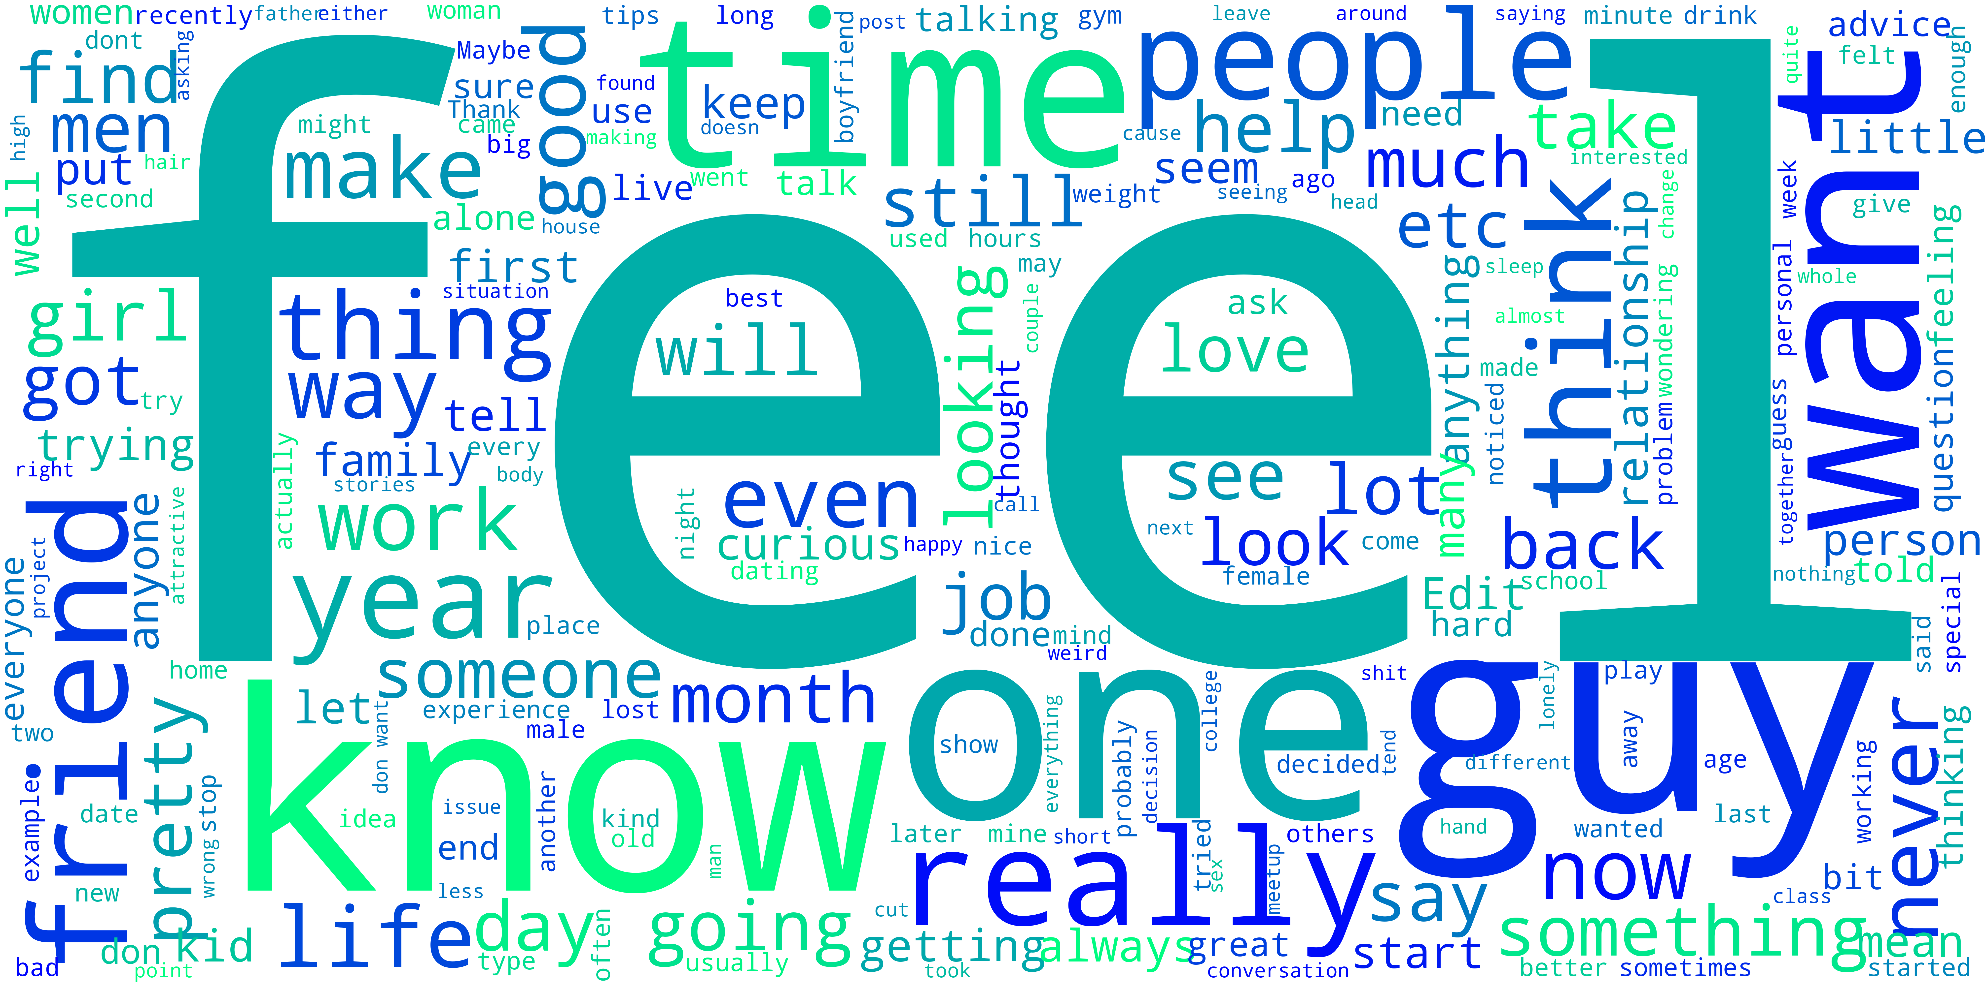

Recommendations:
More data =
more RANTING & VENTING!!!
Better and more advanced
models

